Slide 1
Flight Delay Prediction
By: Shubhangi Mathe

Slide 2
EDA
Outliers: Flight number, tail number, wheels off, wheels on
Number of different airlines: 14
The top three airlines are WN = Southwest, DL = Delta, EV = Atlantic Southeast Airlines
We deleted the missing value which were present in the data.
Different function used in python: mean, median, dropna, loc, sum, isnull, value_counts, info, shape, describe, corr etc
Different types of chart used to show visualization:
Barplot
Scatterplot
Regplot
Boxplot
Catplot
Pie chart
Countplot

Slide 3
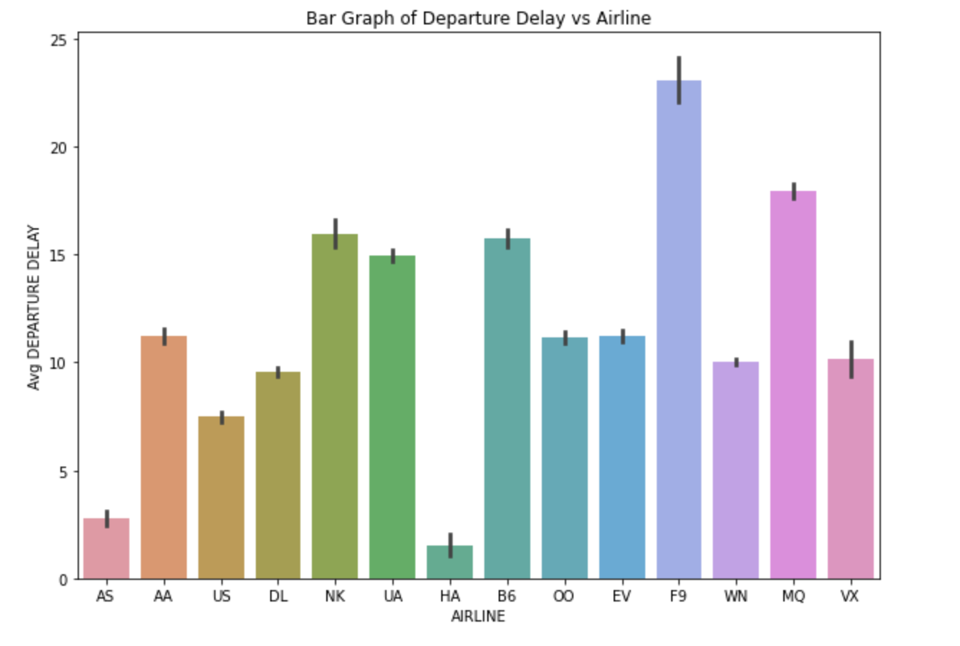
Departure Delay vs Airline
Most airlines have minimal departure delays. NK (Spirit Air Lines), MQ (American Eagle Airlines Inc) and F9 (Frontier Airlines) show more variability/some extreme values.

Slide 4
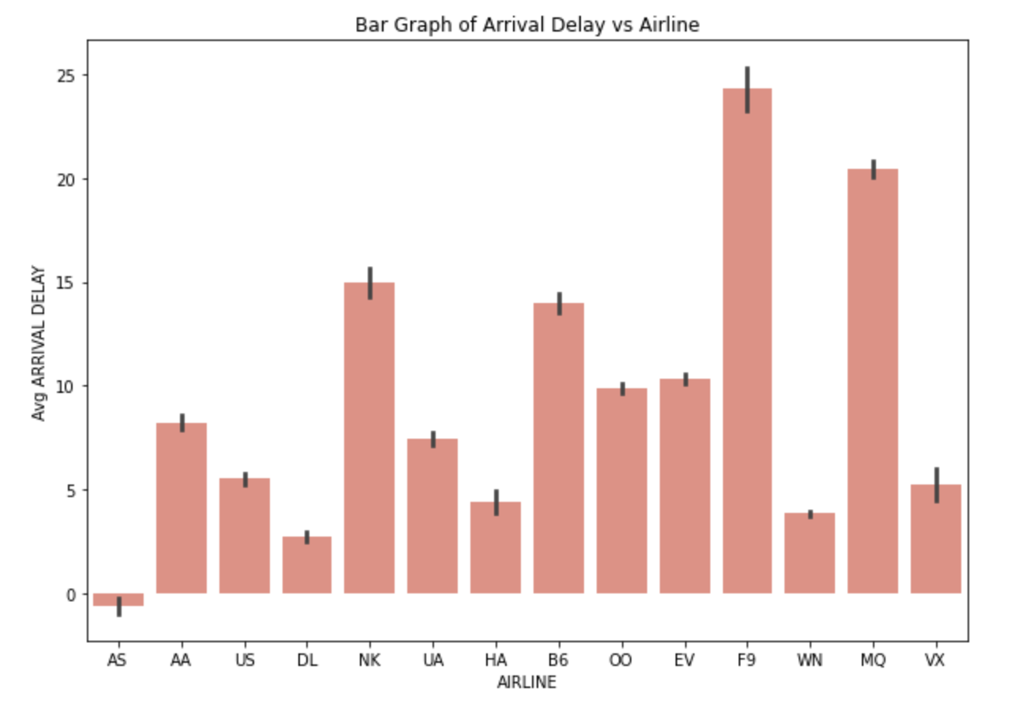
Arrival Delay Vs Airline
Arrival delay variability seems similar with few outliers. Again, MQ (American Eagle Airlines) and F9 (Frontier Airlines) has the most extreme arrival delay.

Slide 5
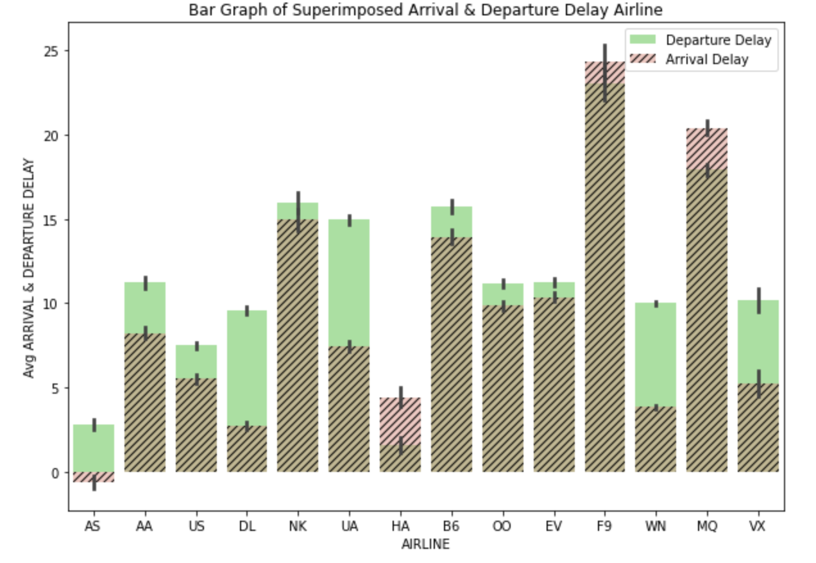
Comparison between Arrival Delay and Departure delay with Airlines
It is observed through superimposed graph that departure delays are higher than arrival delays. One can assume that airlines probably increase speed to minimize delays.

Slide 6
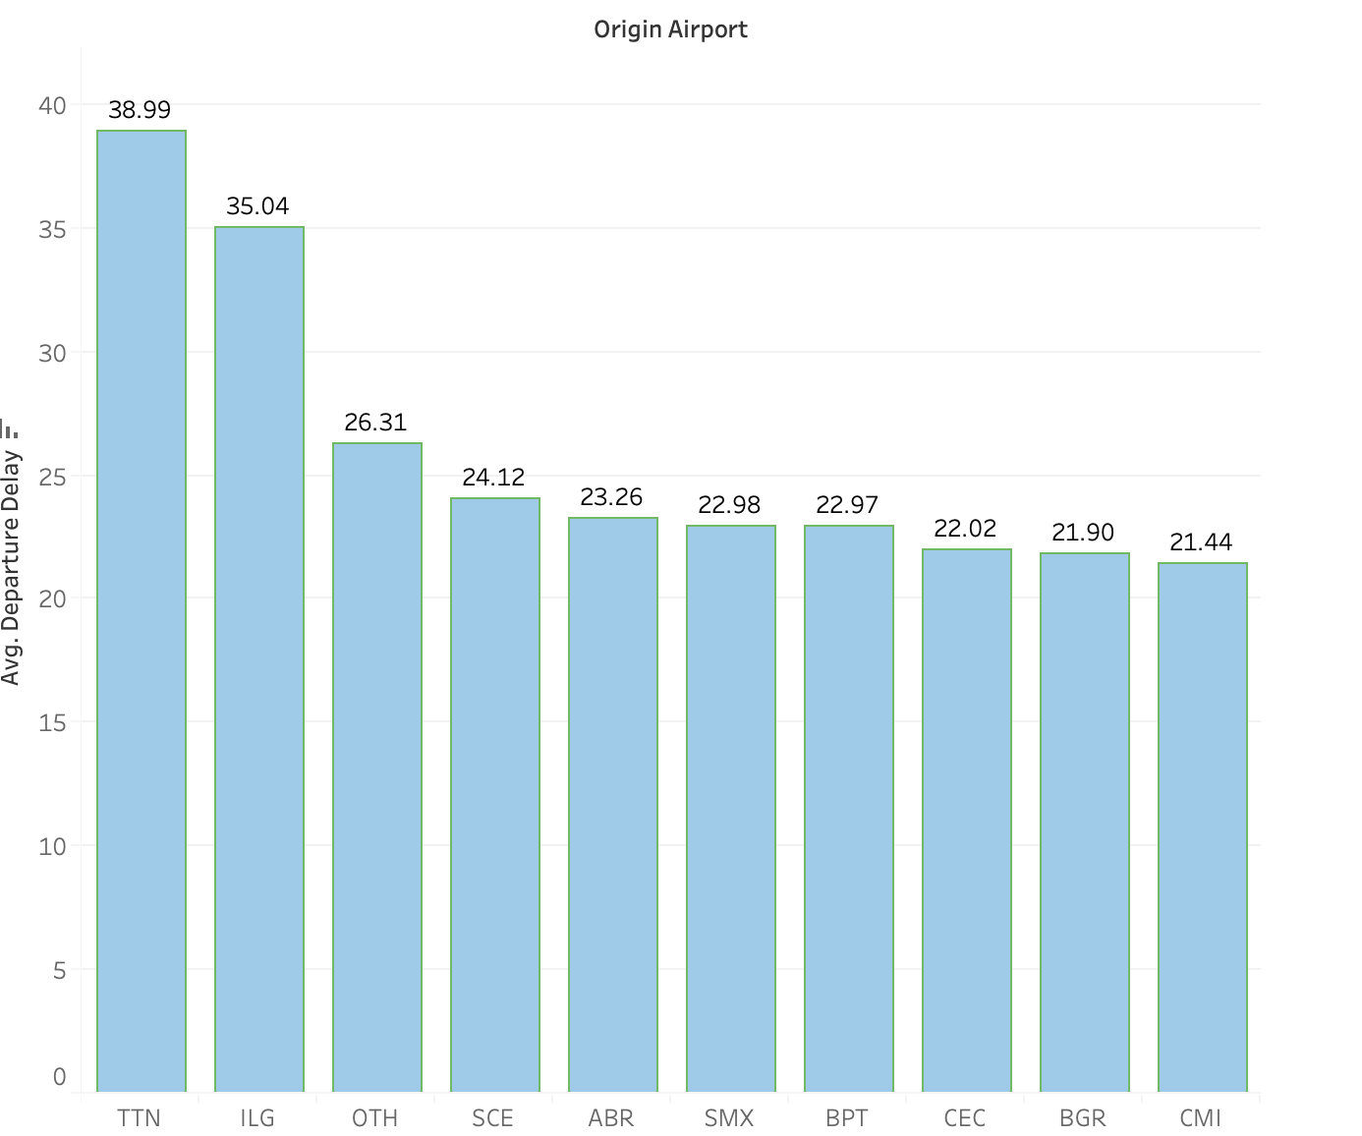
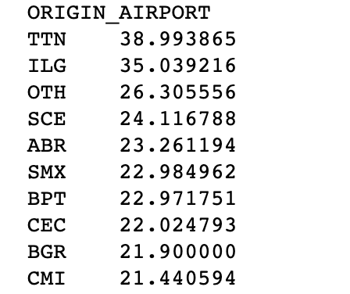
Top 10 airports with most averaged departure delay and analysis of top airport for potential reason
"TTN" origin airport (Trenton Mercer Airport from Trenton) has highest average departure delay. Diving deeper shows there is only one observation for this airport with departure delay of 250 min and arrival delay of 236 min. The flight was not diverted or cancelled but the flight was delayed due to airline delay of 236 min.

Slide 7
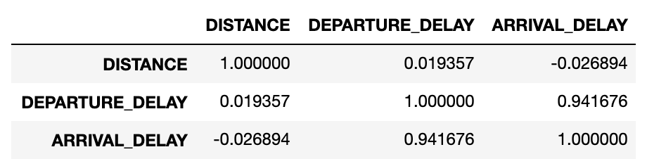
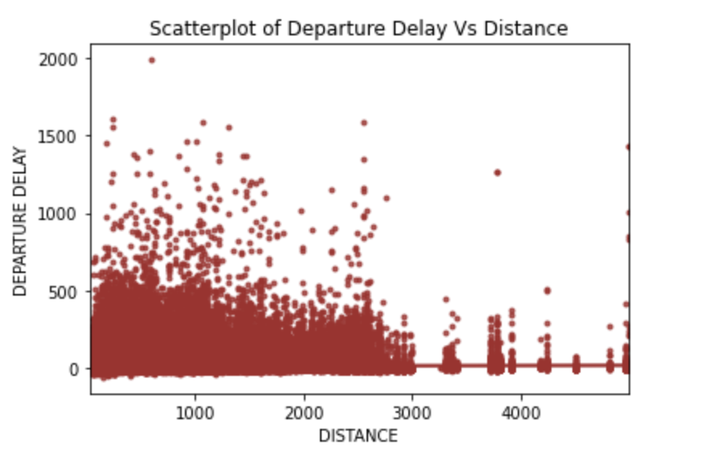
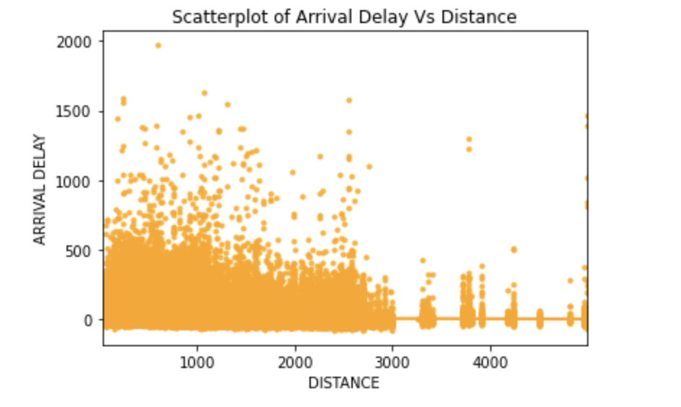
Intuitive analysis - Study if the departure/arrival delay is influenced by distance of trip.

Slide 8
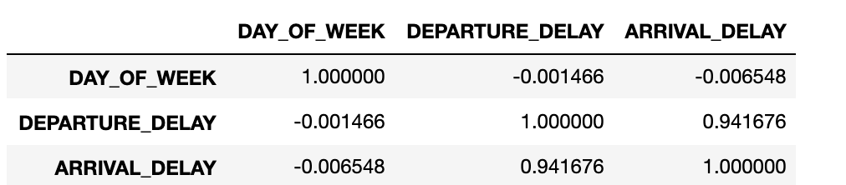
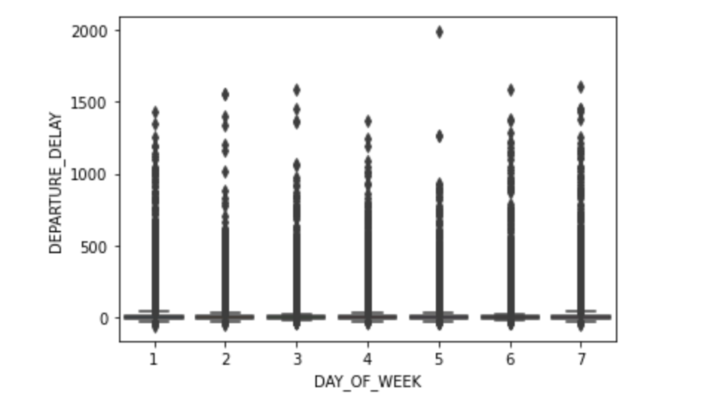
Intuitive analysis - Day of week vs departure delay
Boxplot shows no particular trend because of outliers, therefore, departure delays does not have any relation with the days of the week. It is also seen in the correlation matrix where the value is extremely low (-0.001) between the two.

Slide 9
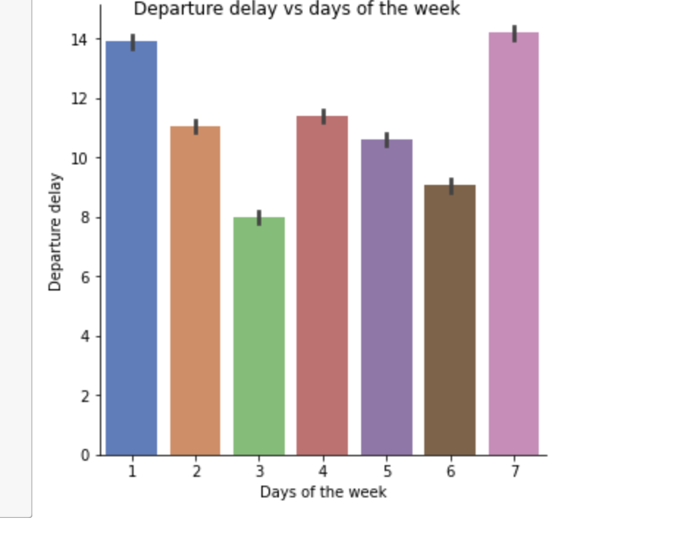
Numerical summary shows Wednesdays and Saturdays have a lower average departure delay, while the Mondays and Sundays shows higher average delay and rest of the week is quite consistent.

Slide 10
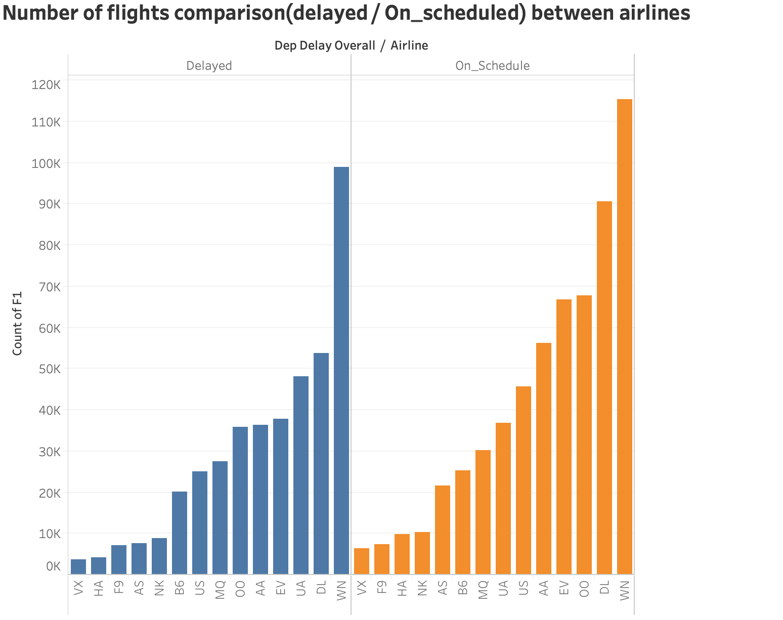
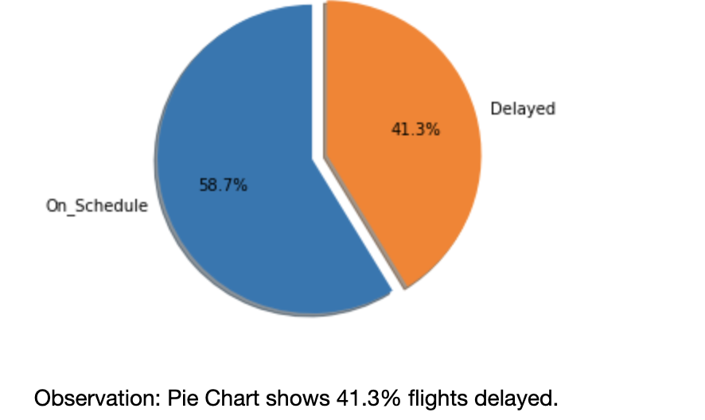

Slide 11
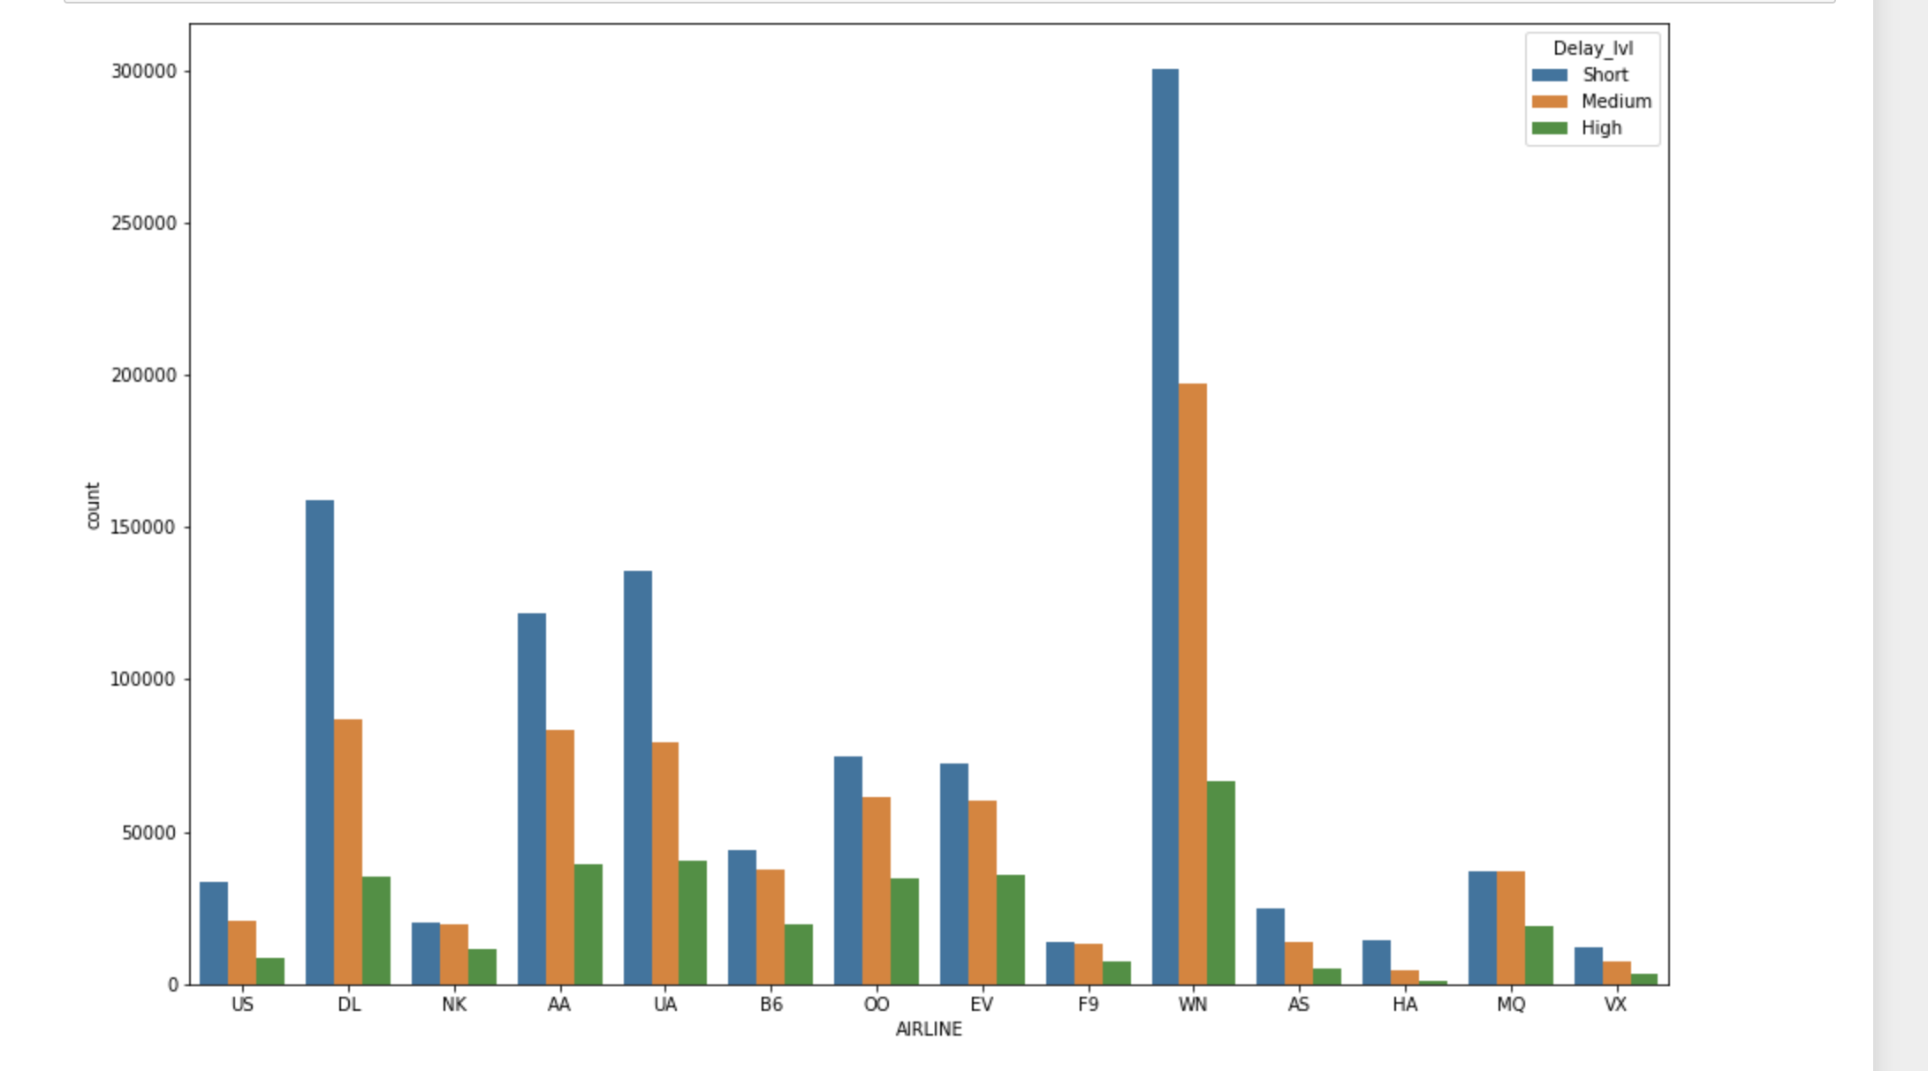
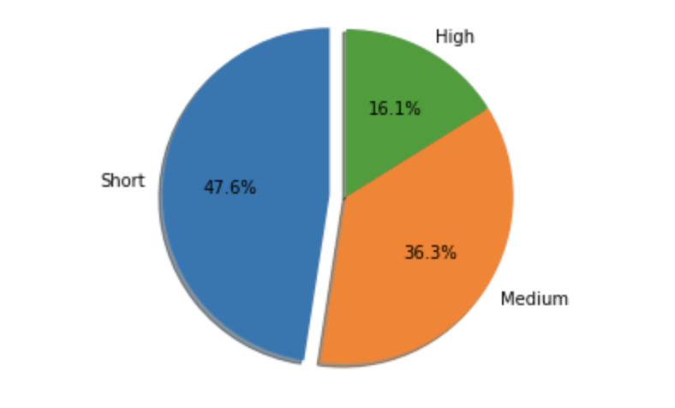
Further, Level of delays are added as dummy variables to see for each airline
To the positive delayed flights, add time based delays. Categories are as below:
Short: 1-15 minutes
Medium: 16-60 minutes
High: above 60 minutes
Graph shows most short delays, i.e. from 1 to 15 minutes for airlines. Also, longer than one hour delays are least. Further, at first glance, predominantly, trend is high delays (longer than 1 hour) are one-third of the short delays.

Slide 12
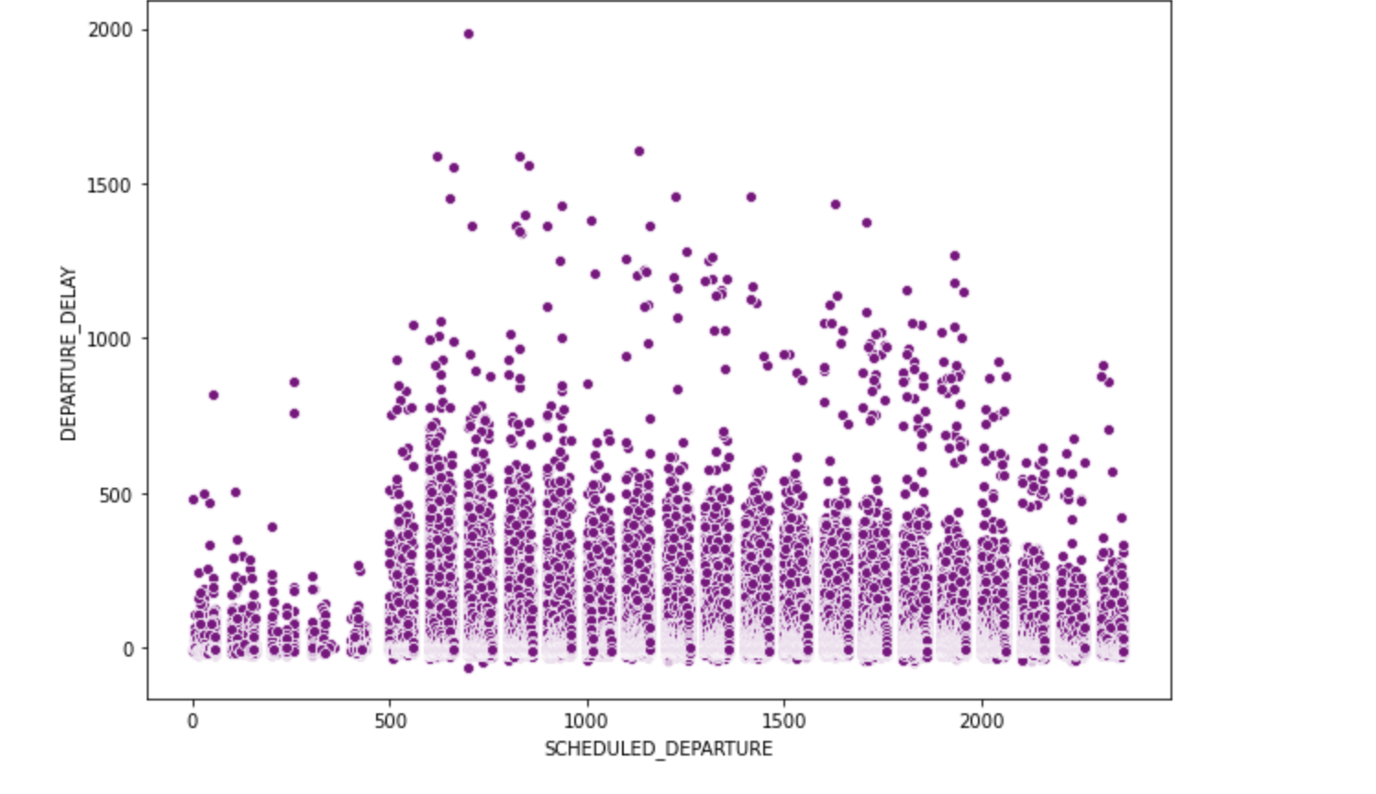
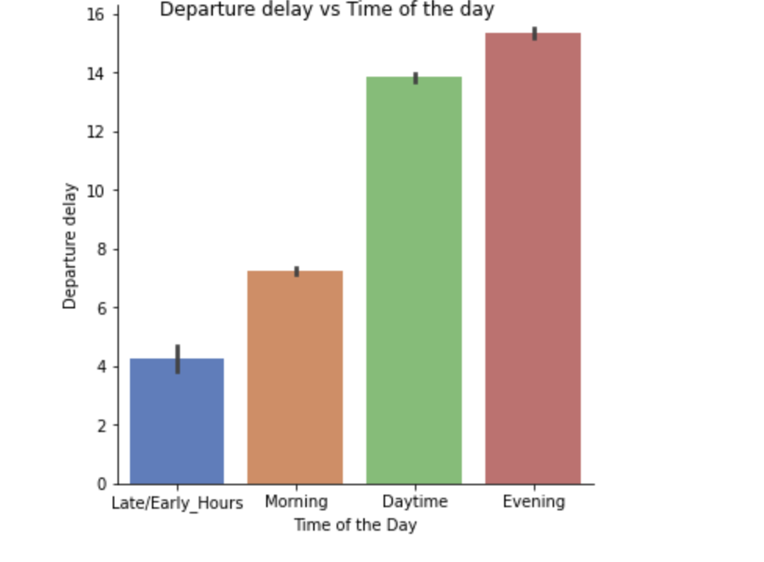
Exploring if there a specific time (or time period) in the day when flight departures are usually delayed or are usually on time.
Graph shows minimal delays particularly around 12am to 5am.
Divided Schedule Departure as below:
600 to 1200: Morning
1200 to 1800: Daytime
1800 to 2400: Evening
> 2400: Late/Early hours

Slide 13
Departure delay
Weather delay
Arrival delay
Parameters affecting the flight delay
Number of flights from each airline
Late Aircraft delay
Air System Delay
Security Delay

